Slide 1
DOCKER CONTAINERS

Slide 2
Docker Containers
A container is a lightweight, stand-alone, executable package of a piece of software that includes everything needed to run it: code, runtime, system tools, system libraries, settings.
Containerized software will always run the same, regardless of the environment.
Containers isolate software from its surroundings, for example differences between development and staging environments and help reduce conflicts between teams running different software on the same infrastructure.

Slide 3
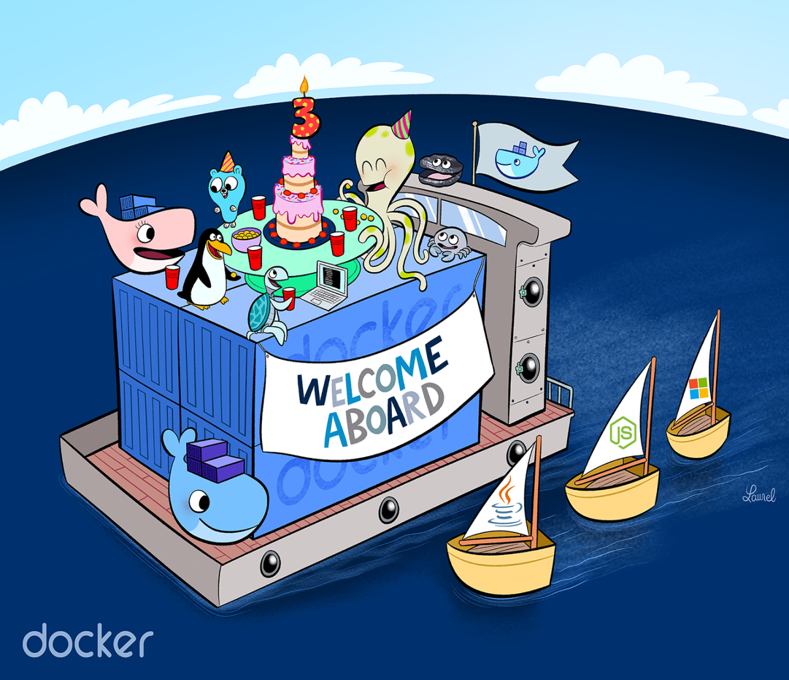

Slide 4
Lets Run our First Container
root@ubuntu:~# docker container run -it ubuntu
Unable to find image 'ubuntu:latest' locally
latest: Pulling from library/ubuntu
1be7f2b886e8: Pull complete
Digest: sha256:e27e9d7f7f28d67aa9e2d7540bdc2b33254b452ee8e60f388875e5b7d9b2b696
Status: Downloaded newer image for ubuntu:latest
root@2fc2c56c92e6:/# cat /etc/os-release
NAME="Ubuntu"
VERSION="16.04.3 LTS (Xenial Xerus)“
Note: We are running a container, open it in interactive mode, and running a command

Slide 5
What docker really did ?
Downloaded the image from Hub / Registry
Generated a new container
Created a new file system
Mounted a read/write layer
Allocated network interface
Setup IP
Setup NAT
Executed bash shell in container

Slide 6
Let’s Try one more ?
root@ubuntu:~# docker container run -d -P nginx
Efe826d8fb9276a6bbcba826769e344e7e1eaac98f23b449249646e2e73d7c6b
root@ubuntu:~# docker container ps
CONTAINER ID IMAGE COMMAND CREATED STATUS PORTS NAMES
efe826d8fb92 nginx "nginx -g 'daemon of…" 6 seconds ago Up 4 seconds 0.0.0.0:32768->80/tcp peaceful_chatterjee
root@ubuntu:~#
You must see something like: 0.0.0.0:32768->80/tcp
Go to web browser and enter url: <IPAddr>:32768
Docker exposed port 80 (default nginx webserver port) to our host in port 32768
Note: We are running a container, in detached mode & assigning a port on localhost

Slide 7
Some Commands
docker container ps → list all running containers
docker container ps –a → list all running & dead containers
docker container commit → Create a new image from a container’s changes
docker container cp → Copy files/folders between a container and the local filesystem
docker container create → Create a new container
docker container diff → Inspect changes to files or directories on a container’s filesystem
docker container exec → Run a command in a running container
docker container export → Export a container’s filesystem as a tar archive
docker container inspect → Display detailed information on one or more containers
docker container kill → Kill one or more running containers
docker container logs → Fetch the logs of a container
docker container ls → List containers
docker container pause → Pause all processes within one or more containers
docker container port → List port mappings or a specific mapping for the container
docker container prune → Remove all stopped containers
docker container rename → Rename a container
docker container restart → Restart one or more containers
docker container rm → Remove one or more containers
docker container run → Run a command in a new container

Slide 8
DOCKER IMAGES

Slide 9
Docker Images
Definition:
An image is an inert, immutable, file that's essentially a snapshot of a container. Images are created with the build/commit command.
Images are stored in a Docker registry such as registry.hub.docker.com
How to Build ? Actually two ways
Update container created from an image and commit the results to a new image
Create Dockerfile

Slide 10
[1] Creating from a Container
Pull an Ubuntu Image from Docker Hub using docker pull & run it interactive mode
root@ubuntu:~# docker pull ubuntu
Using default tag: latest
latest: Pulling from library/ubuntu
Digest:sha256:e27e9d7f7f28d67aa9e2d7540bdc2b33254b452ee8e60f388875e5b7d9b2b696
Status: Image is up to date for ubuntu:latest
root@ubuntu:~#
Lets Run the image in interactive & run a curl command to check weather it works
root@ubuntu:~# docker container run -it ubuntu /bin/bash
root@bc86151da244:/# curl www.google.com #### here we are inside the container
bash: curl: command not found
curl command not found ? Lets install it. Run as below
root@bc86151da244:/# apt-get update
Get:1 http://archive.ubuntu.com/ubuntu xenial InRelease [247 kB]
Reading package lists... Done #### ensure you get this
root@bc86151da244:/# apt-get install -y curl
Reading package lists... Done
Building dependency tree
Reading state information... Done
Done.

Slide 11
Continued…
Lets Try the curl work now
root@bc86151da244:/# curl www.google.com
<HTML><HEAD><meta http-equiv="content-type" content="text/html;charset=utf-8">
<TITLE>302 Moved</TITLE></HEAD><BODY>
</BODY></HTML>
It worked…. Lets commit this container to a new image which has curl
Get out of the container to commit into a new image
to come out of the container issue: Ctrl+pq
Note: ensure you are not killing the container if killed all changes we did will be lost
Now on host OS command line issue below.
root@ubuntu:~# docker commit -m "ubuntu with curl" bc86151da244 myubuntu:curl
sha256:d23a4e78c1aa52e6983038f369f9b6732eb550d47de80cf9b24faa6a7c1e225
Lets check our images created
root@ubuntu:~# docker images
REPOSITORY TAG IMAGE ID CREATED SIZE
myubuntu curl d23a4e78c1aa 4 minutes ago 168MB

Slide 12
[2] Creating from a Dockerfile
Dockerfile is a text file that contains all the commands, in order, needed to build a image
Dockerfiles adhere to a specific format and use a specific set of instructions.
https://docs.docker.com/develop/develop-images/dockerfile_best-practices/
Useful command: FROM, RUN, WORKDIR, EXPOSE, CMD, ADD

Slide 13
On your VM do the following
root@ubuntu:/home/devops# mkdir -p /home/docker ; cd /home/docker ; touch Dockerfile
root@ubuntu:/home/docker# vi Dockerfile
FROM debian:latest
RUN apt-get update
RUN apt-get install -y procps vim curl nginx
EXPOSE 80
CMD /usr/sbin/nginx -g "daemon off;“
Save & Exit the file
To build the image from Docker file now run below
root@ubuntu:# cd /home/docker ; docker build -t mynginx .
Check the images
root@ubuntu:/home/docker# docker images
REPOSITORY TAG IMAGE ID CREATED SIZE
mynginx latest 3d247ee52299 11 minutes ago 225MB

Slide 14

How do we transfer the images across the systems ?
Push the images to a Repository & Pull it on required machines (using Docker Push & Pull Commands )
Private Repo ( Docker Trusted Registry DTR )
Public Repo ( Docker Hub )
Save it as tar file & SCP to the required machines
(using Docker Save & Docker Load Commands) (not suggested)

Slide 15
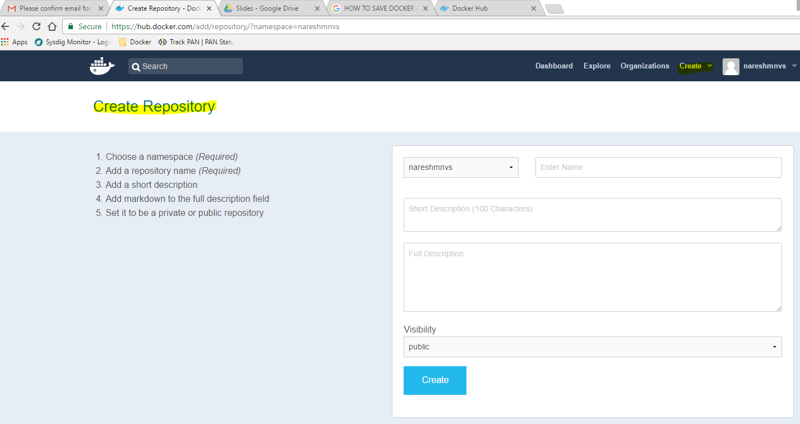
Lets Try Pushing Image to Docker Hub
Goto : https://hub.docker.com/ & create an account
Verify your account
Login to your account & create a repo called alpine

Slide 16
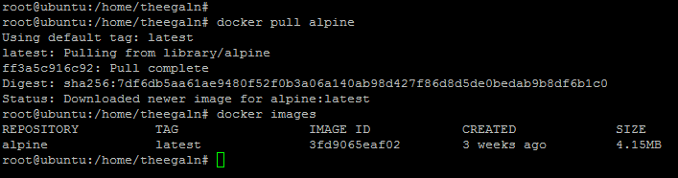
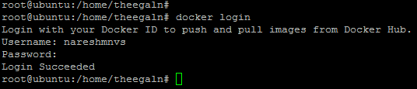
Now On your Machine pull a image called alpine
i.e docker pull alpine
Lets Login to your Account through command line to push alpine image into our repo

Slide 17
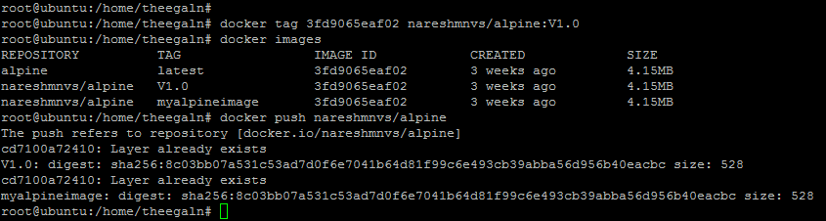
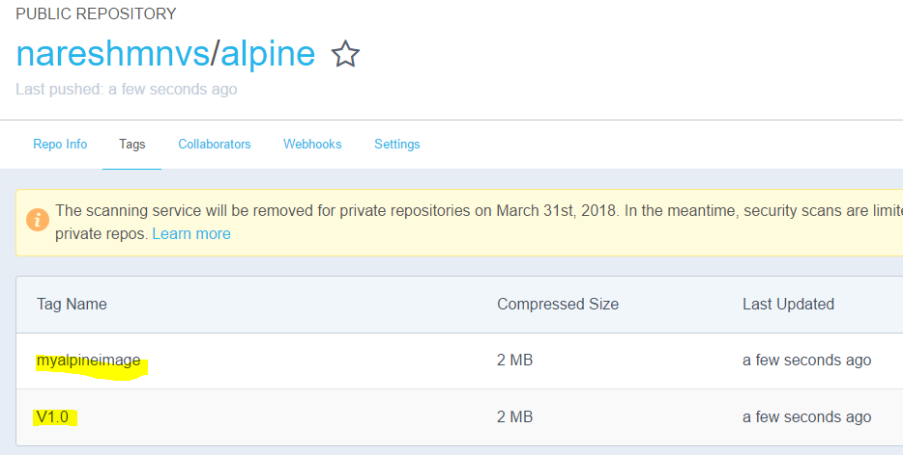
Lets Push the alpine image now to our repo using docker push
Note: We need to tag our image with our repo name to push them to our repo

Slide 18
DTR: Docker Trusted Registry
is a Private repository just like docker hub but it lives in your Data Center, so that images in DTR can be accessed by only your company
We need to setup the DTR in your local to push pull the images, once we setup DTR we will have similar UI to login and create your own repo as we did in Docker Hub
We can use the same commands which we used for docker hub, the difference is you need to add your repo addr to login & push
example:
docker login <repo addr>
docker tag <image id/name> repoaddr/loginid/reponame:tag
docker push repoaddr/loginid/reponame:tag
More Info on DTR:
https://docs.docker.com/datacenter/dtr/2.4/guides/architecture/

Slide 19
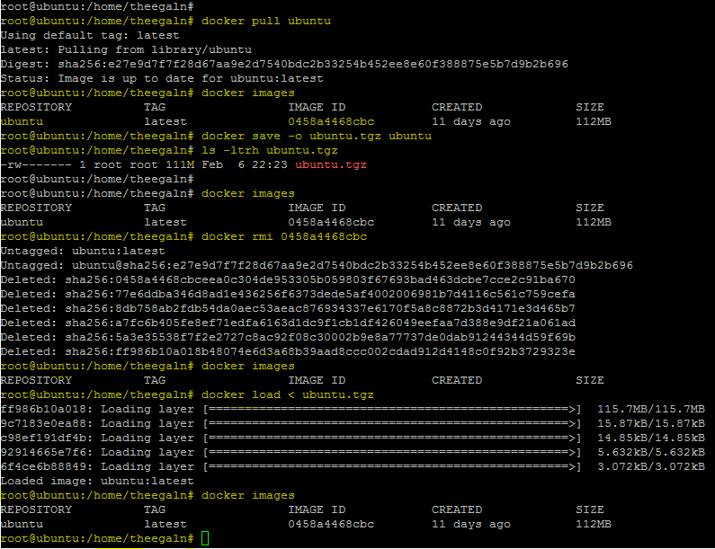
Save as tar file & move using SCP

Slide 20


